Slide 1
Accent Classification
A premise to L1-L2 speech accent modifications
Roll No. :- MDS008
Name :- Malvi Shah
M.Tech :- Data Science
Supervision :- Dr. Tanmay Bhowmik
01

Slide 2
CONTENT
Introduction
Motivation
Objective
Literature Review
Identified Gaps
Proposed Methodology
Results
Conclusion & Future Scope
References
02

Slide 3
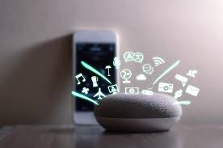


Introduction
Home assistants (Apple Siri and Google Home etc.) - integral part of our lives.
Problem:
1.Non-native speakers frequently facing problems with automated assistants.
2.Speech which are get from devices that are not typical in normal pronunciation.
https://www.facebook.com/people/Home-Assistant-Devices/100038545516935/
03

Slide 4
Solution :
user speech
Classify accent
L2 speaker
Convert into native English accent
Home Assistant
L1 speaker
04

Slide 5
Motivation
Communication barriers arising because of accent distinctness.
It used to improve speech recognition software.
The speech of non-native speakers who nowadays represent the vast majority of users.
05

Slide 6
Objective
To recognize non-native(L2) accents from short audio clips or audio snippets.
To overcome the degradation problem caused by accents.
06

Slide 7
Literature Review
Sr. No. | Paper | Method | Author | Publisher Name
1. | Foreign Accent Conversion by Synthesizing Speech from Phonetic Posteriorgrams | Our system is composed of three major components; a speaker independent acoustic model (AM) that extracts PPGs, a speech synthesizer for the non-native speaker that converts PPGs into mel-spectrograms, and a WaveGlow vocoder to generate speech waveform from the mel-spectrograms in real-time. | Guanlong Zhao, Shaojin Ding, Ricardo Gutierrez-Osuna | INTERSPEECH 2019
2. | The purpose of this method is to increase the accuracy of ASR systems which had already been developed and trained using a native speech dataset, without the necessity to train new ASR models adapted for a specific non-native accent. | Accent modification for speech recognition of non-native speakers using neural style transfer | Kacper Radzikowski1,2*† , Le Wang1†, Osamu Yoshie1† and Robert Nowak2 | EURASIP Journal on Audio, Speech, and Music
07

Slide 8
Literature Review
Sr. No. | Paper | Method | Author | Publisher Name
3. | Automatic conversion between pronunciations of different English accents | Decision Tree | Linsen Loots, Thomas Niesler | www.elsevier.com/locate/specom
4. | Foreign Accent Conversion through Voice Morphing | Our method for morphing accent conversion is based on the pulse density modulation (PDM) technique | Sandesh Aryal, Daniel Felps, and Ricardo Gutierrez-Osuna | INTERSPEECH 2013
08

Slide 9
Identified Gaps
In this paper, several issues were identified while performing this model and the main gap is that of multiple speaker-dependent conditions and other non-native nationalities.[1]
The ultimate goal of accent conversion is to eliminate the need for a reference utterance at synthesis time, i.e., to take a non-native utterance and automatically reduce its accent.[2]
Furthermore, a superior and more precise version is plausible by acquiring additional voice samples for each language. [3]
09

Slide 10
Proposed Methodology
Dataset used :-
The Speech Accent Archive.
2140 speech samples. All are unique speakers.
Speakers have 214 distinct native languages and come from 177 countries.
Information of speakers given in 6 columns.
Table 1 : Data Types of each column in the datasets.
Data Types | Columns
Discrete (Numerical) | Age, age onset
Nominal (Categorical) | Birthplace, sex, country
10

Slide 11
Table 2 : Number of audio samples per accent class.
Accent | Number of samples
Native accent | 373
Non-native accent | 1767
Total | 2140
Programming Language – Python
Platform - Jupyter Notebook
11

Slide 12
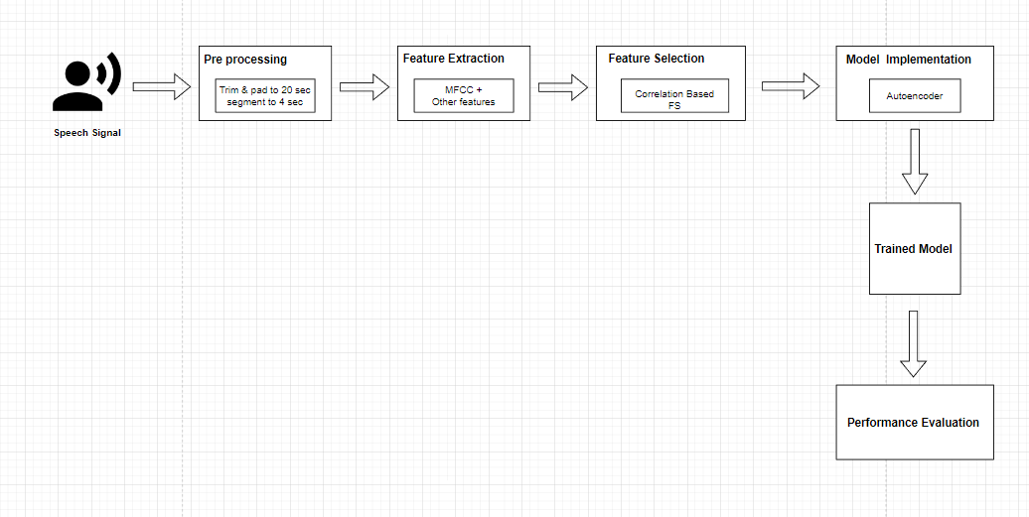
Accent Classification :-
Work Flow Diagram
12

Slide 13
Results
System performance of SVM classifier
Sr. No. | Features | Precision | Recall | F1 Score | Accuracy
1 | Hybrid | 0.7 | 0.83 | 0.76 | 0.84
2 | Hybrid + MFCC | 0.66 | 0.81 | 0.73 | 0.82
3 | Hybrid + MFCC + Delta + Double Delta | 0.69 | 0.82 | 0.75 | 0.83
4 | Only MFCC | 0.66 | 0.81 | 0.73 | 0.82
5 | MFCC + Delta + Double Delta | 0.71 | 0.84 | 0.77 | 0.85
13

Slide 14
System performance of XgBoost classifier
Sr. No. | Features | Precision | Recall | F1 Score | Accuracy
1 | Hybrid | 0.75 | 0.81 | 0.77 | 0.81
2 | Hybrid + MFCC | 0.74 | 0.8 | 0.75 | 0.81
3 | Hybrid + MFCC + Delta + Double Delta | 0.76 | 0.82 | 0.77 | 0.82
4 | Only MFCC | 0.73 | 0.79 | 0.75 | 0.8
5 | MFCC + Delta + Double Delta | 0.79 | 0.84 | 0.79 | 0.85
14

Slide 15
System performance of CNN
Sr. No. | Features | Precision | Recall | F1 Score | Accuracy
1 | Hybrid | 0.68 | 0.82 | 0.75 | 0.83
2 | Hybrid + MFCC | 0.73 | 0.78 | 0.75 | 0.79
3 | Hybrid + MFCC + Delta + Double Delta | 0.74 | 0.79 | 0.76 | 0.79
4 | Only MFCC | 0.73 | 0.77 | 0.74 | 0.77
5 | MFCC + Delta + Double Delta | 0.74 | 0.77 | 0.76 | 0.78
15

Slide 16
Challenges
Overcome the degradation problem caused by accents has become one of the most important challenges.
To divide the speech signal into accent-related cues and voice quality.
Models need at least one hour of speech from the non-native speaker.
16

Slide 17
Conclusion & Future Scope
Conclusion :-
Experimented with different acoustic feature sets and ML models.
Best results on MFCC+ Delta + Double Delta spectral features.
Future scope :-
Work on open-source dataset with > 10k audio samples.
Apply other neural networks like RNN, RCNN.
Use Transfer Learning on spectrogram images for accent classification.
17

Slide 18
References
Radzikowski, K., Wang, L., Yoshie, O., & Nowak, R. (2021). Accent modification for speech recognition of non-native speakers using neural style transfer. EURASIP Journal on Audio, Speech, and Music Processing, 2021(1), 1-10.
Zhao, G., Ding, S., & Gutierrez-Osuna, R. (2019). Foreign Accent Conversion by Synthesizing Speech from Phonetic Posteriorgrams. In INTERSPEECH (pp. 2843-2847).
Loots, L., & Niesler, T. (2011). Automatic conversion between pronunciations of different English accents. Speech Communication, 53(1), 75-84.
18

Slide 19
Thank You:)

